Slide 1
Templates

Slide 2
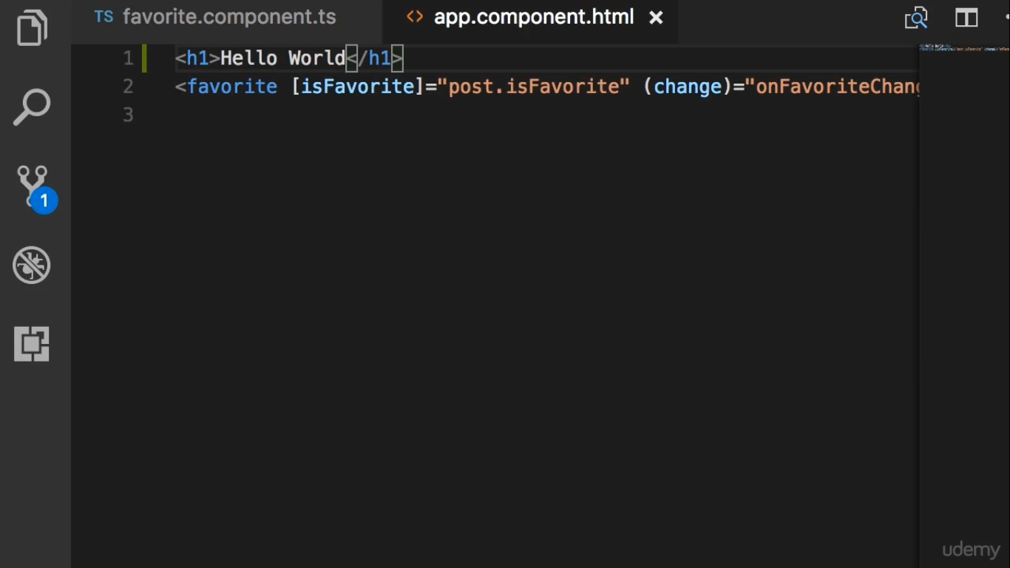

Slide 3
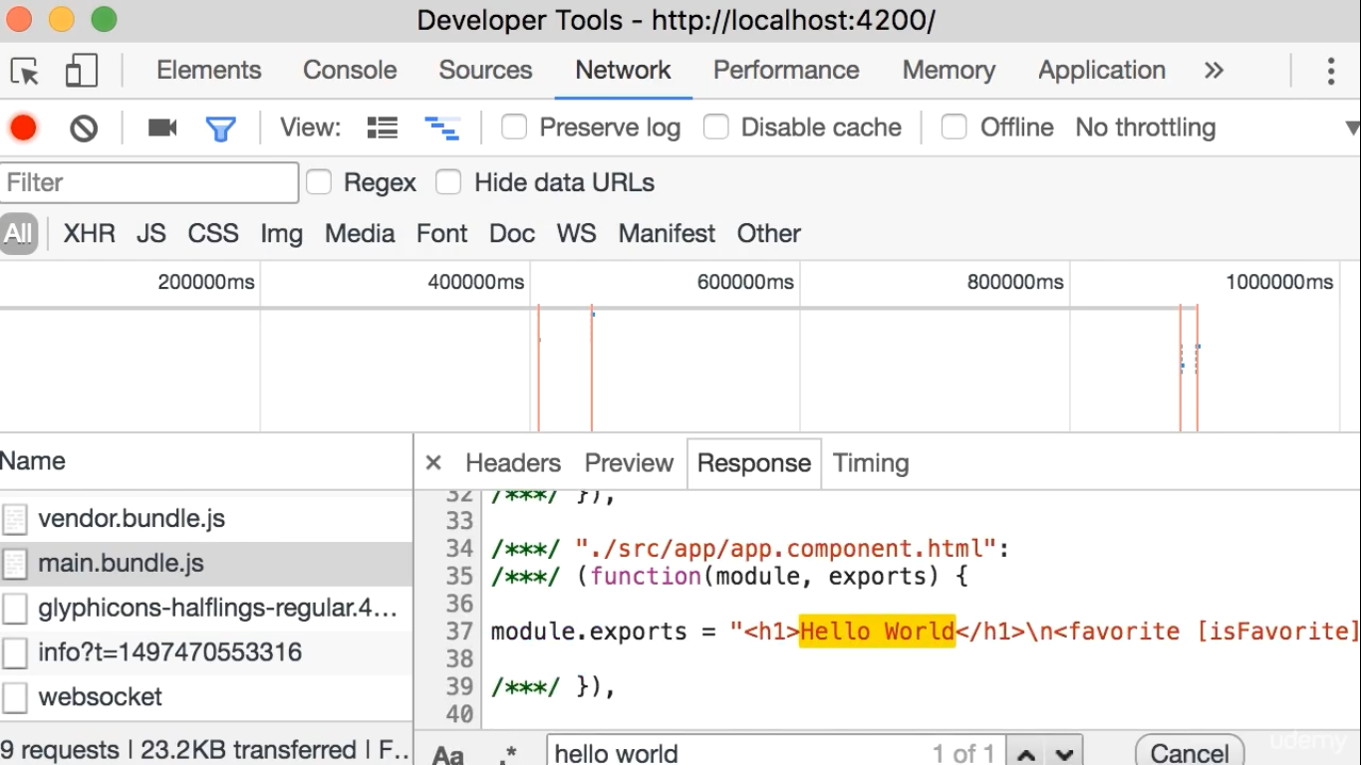
Template exists within main.bundle.js
No several request to download this template

